Slide 1
A DATA MINING PROJECT
what 21 years of food prices say about a country in flux
the world food programme tracked the price of everyday food in 76 markets across cameroon. this is what the numbers reveal.
cameroon
2005 — 2026
55,660 observations

Slide 2
00 / PROLOGUE
first, the numbers.
this story rests on a single csv from the world food programme — the un agency that monitors hunger.
nine regions, not ten. the missing one is Sud, the peaceful south. wfp follows need, so its data goes where the crises are: the far north, the anglophone regions, the east.
55,660
9 / 10
RECORDS
REGIONS COVERED
76
51
MARKETS
COMMODITIES
21
1
YEARS OF HISTORY
REGION MISSING — SUD
cameroon food prices · a data mining story
02

Slide 3
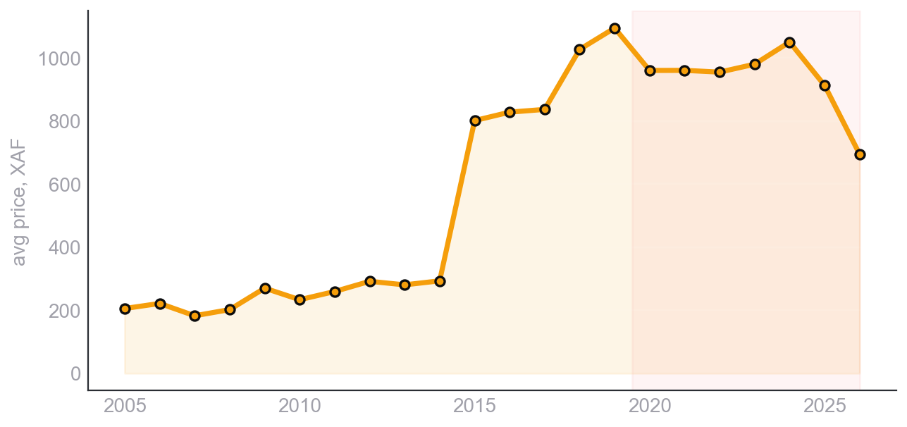
01 / THE DATA
before any model, you look.
NATIONAL AVERAGE PRICE BY YEAR — A LONG CLIMB, THEN A POST-2020 JUMP
a long climb
prices drift up for 15 years, then accelerate after 2020 — covid, war, inflation.
a lean season
june to august sit above the line every year, between harvests.
a crisis map
extreme nord dominates the records 3:1 — wfp monitors where hunger is.
imports cost
processed and imported goods sit far above local staples per kilo.
cameroon food prices · a data mining story
03

Slide 4
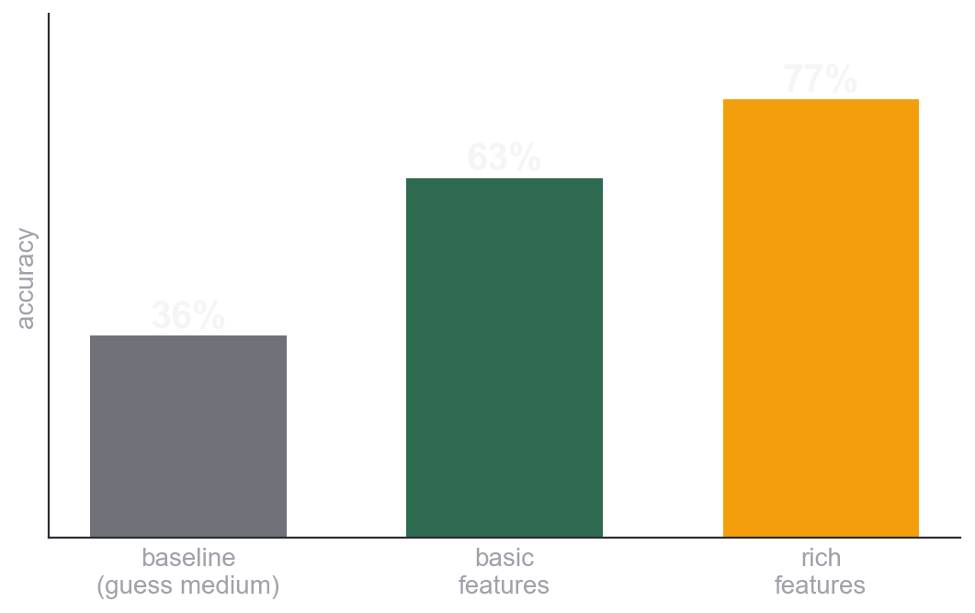
02 / CLASSIFICATION
can a model read a price tier?
THE ARC: SAME ALGORITHM, BETTER FEATURES
77%
accuracy on held-out data, up from 63%.
a random forest labels each price Low / Medium / High against its own commodity's history. the lift came from feature engineering, not a bigger model: market location plus recent and yearly median price.
cameroon food prices · a data mining story
04

Slide 5
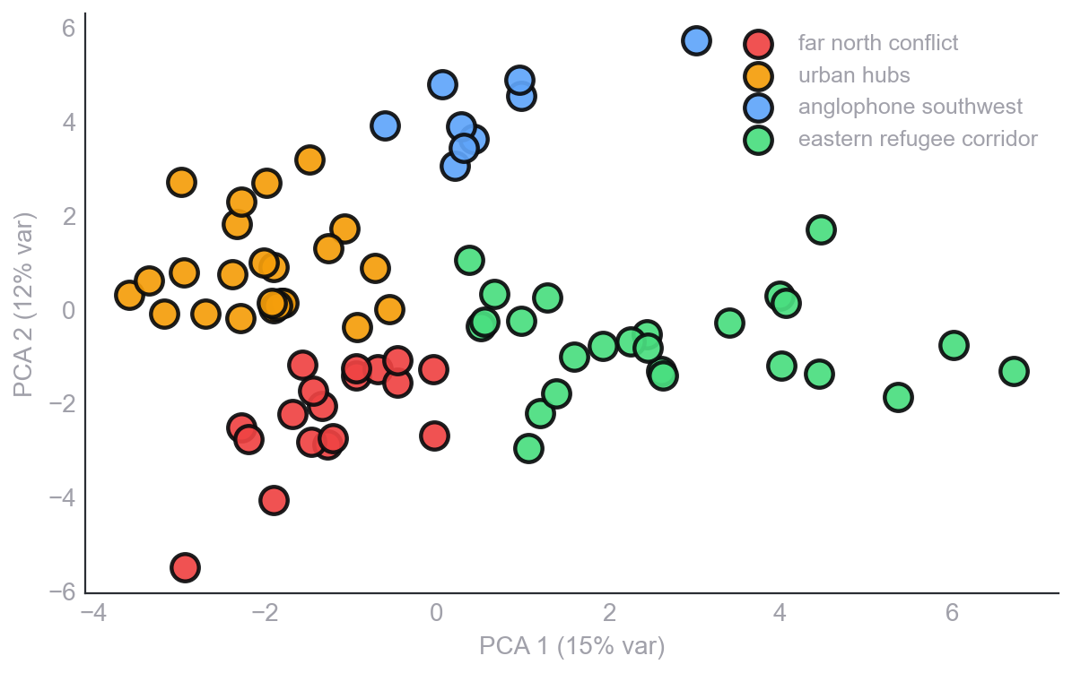
03 / CLUSTERS
let the data draw the map.
76 MARKETS BY PRICE PROFILE, PROJECTED TO 2D — K-MEANS, k = 4
k-means knew nothing about politics. it saw only prices — and rebuilt the country's crisis geography.
cluster 00
far north conflict zone
cluster 01
urban commercial hubs
cluster 02
anglophone southwest
cluster 03
eastern refugee corridor
cameroon food prices · a data mining story
05

Slide 6
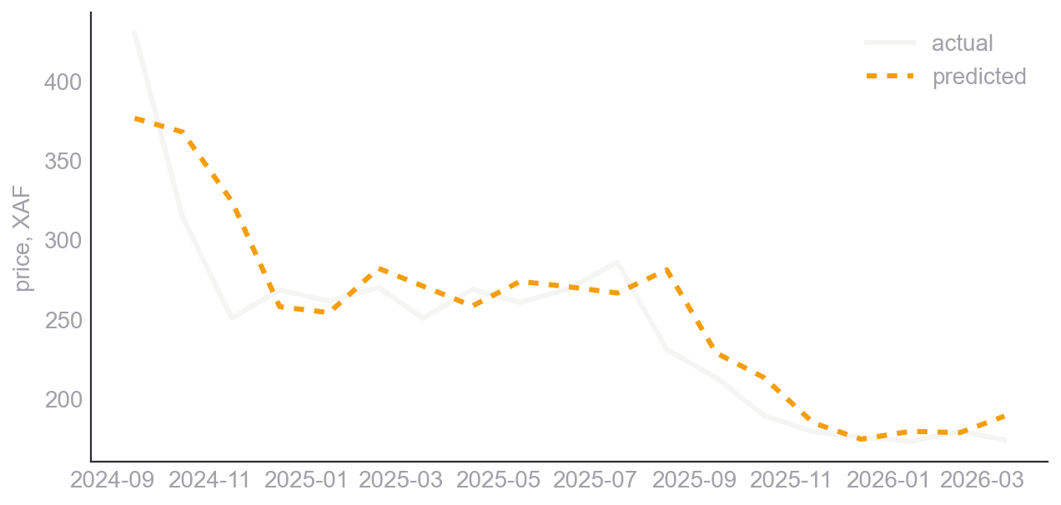
04 / FORECASTING
how well can we see one month ahead?
0.94
ACTUAL VS PREDICTED — MAIZE (WHITE), THROUGH THE POST-2020 WAVE
pooled R², up from 0.48
01
use more data
train on the top 10 commodities, not maize alone — 10x the rows.
02
predict log price
a 10% move counts the same on cheap and dear items.
03
gradient boosting
trees that learn from each other's mistakes, built for trend and season.
cameroon food prices · a data mining story
06

Slide 7
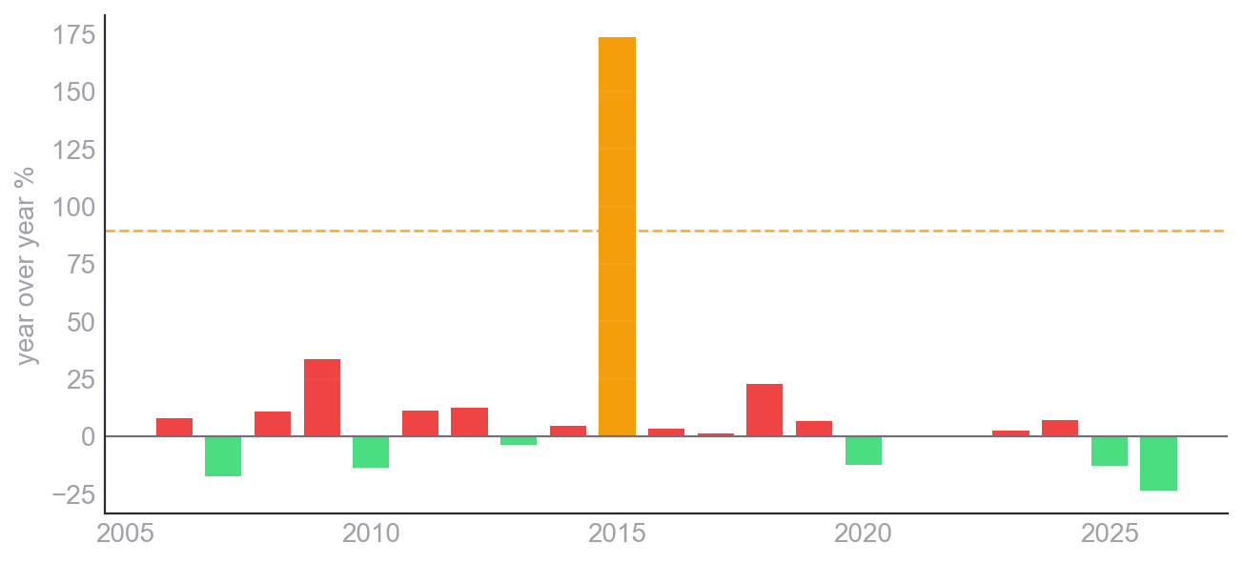
05 / PATTERNS
when the system cracked.
YEAR-OVER-YEAR PRICE CHANGE — AMBER BARS CROSS THE 2-SIGMA ANOMALY LINE
two shocks, found without labels
2008
the global food price crisis.
2022
post-covid inflation plus the war on grain.
volatile
animal products and oils swing most; cereals are policy-stabilised.
cameroon food prices · a data mining story
07

Slide 8
06 / CONCLUSION
what the data said.
01
02
prices are structured, not chaotic
when beats where
a classifier reads them at 77% and a forecaster hits 0.94 pooled R².
recent history and inflation context predict price better than geography.
03
04
markets map to crisis
two system shocks
four price clusters line up with cameroon's humanitarian zones.
2008 and 2022 surface cleanly, with no one labelling them.
numbers, given time, will tell on the world.
cameroon food prices · a data mining story
08

